Slide 1


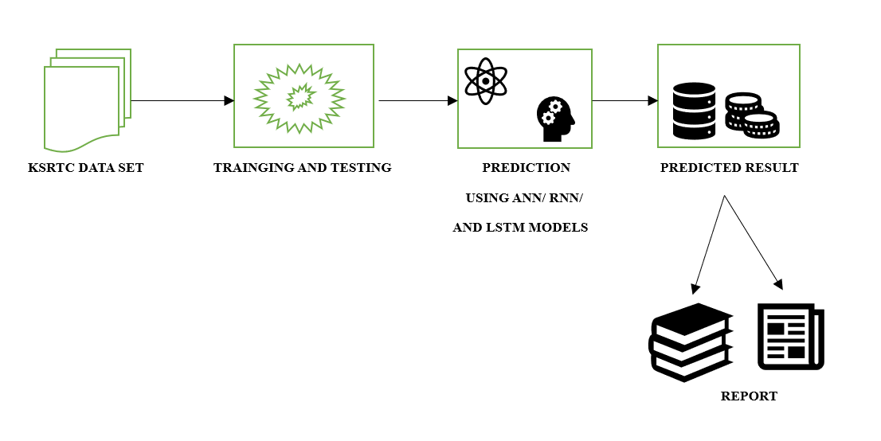
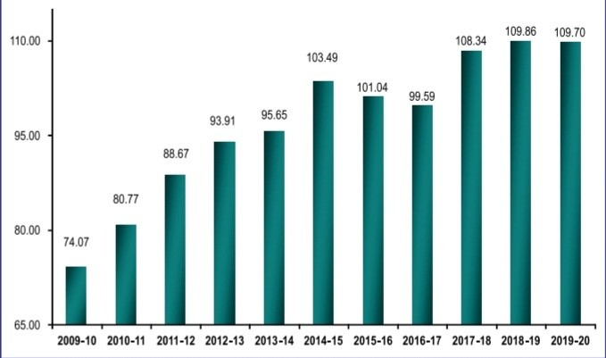
KARNATAKA STATE SCIENCE AND TECHNOLOGY
BILURU GURUBASAVA MAHASWAMIJI INSTITUTE OF TECHNOLOGY
^{MUDHOL}
PROPOSAL REFERENCE NO. 47S_BE_0343
CROWD PREDICTION FOR BUSLINES USING ARTIFICIAL INTELLIGENCE
PROJECT ASSOCIATES: UNDER THE GUIDENCE OF
MR. GOPAL CHENNI USN: 2LB20CS005 PROF. VARUN P. SARVADE
MISS PRADNYA BILAGI USN:2LB20CS015 ASSISTANT PROFESSOR
MR. DHANUSH YADAV USN:2LB20CS003 DEPT. OF COMPUTER SCIENCE AND ENGINEERING
MR. NIRANJAN PURAD USN:2LB20CS013 BGMIT MUDHOL
ABSTRACT
BLOCK DIAGRAM
It is important to determine the passenger flow in each station, and the authorities may utilize this information to schedule buses. In Our proposed system we are using deep learning method to KSRTC passenger flow. The proposed work will provide solution for controllers, passengers and also public transportation owners a better way for handling the crowd, and optimize fuel consumption. The proposed work also aims to improve travel experience, reduce waiting times, improve operational efficiency, and reduced congestion.
SCOPE
Figure:2 Proposed System
Only KSRTC data set is considered for this system. The model
can be further improved by considering data from all govt. bus line throughout India.
REQUIREMENT SPECIFICATION
INTRODUCTION
HARDWERE USED
• Processor: 12th Gen Intel(R) Core(TM) i5-1235U 1.30 GHz
• Memory: 8.00 GB • Hard Disk space: 2GB Others: Computer peripherals, such as keyboard and mouse
SOFTWERE USED
• Operating System: Windows 11
• Google Collab
Transportation is one of the major parts of modern society, with public bus/rail transport being the most popular. Hence Predicting crowd flow for bus routes is of at most importance. Accurate predictions helps in fuel cost saving and improves the passenger journey. Hence we propose the use of Deep Learning techniques like RNN for better accuracy Public transportation plays a vital role in urban mobility, but overcrowding on buses often leads to inconvenience, discomfort, and safety concerns for passengers. To address this challenge, we aim to develop an artificial intelligence-based crowd prediction system for a bus line. The system will utilize historical data to forecast bus demand accurately.
RESULTS
Sl No | Decision Tree | ANN | LSTM | RNN
Accuracy | 99% | 53% | 93% | 97%
Loss | 24% | 10% | 20% | 15%
RELATED WORK
ADVANTAGES
The authors of the paper [1] have presented a research on Deep Learning-Based Passenger Flow Prediction using CSV passenger data from KSRTC. They have compared RNN, LSTM, and greedy algorithms. RNN approach had best accuracy of 92.97% with RMSE of 2.344. This model helps in enhancing traveler experience and aids in passenger management
Reduced waiting time.
Improved crowd prediction accuracy.
Optimized resource allocation Reduced operational costs.
Improved infrastructure planning.
CONCLUSION
PASSENGERS V/S YEAR GRAPH
The crowd prediction project for the bus line, utilizing AI, has yielded insightful conclusions. Through the implementation of sophisticated algorithms and machine learning techniques, we have successfully forecasted optimized bus usage with notable accuracy. Our model's ability to analyze various factors such as source, destination, trip, route, slot no, and other parameters has proven instrumental in generating reliable predictions. In this project Decision tree, ANN model, LSTM model and RNN model gives 99%, 51%, 95% and 96% of accuracy score respectively.
REFERENCE
[1] Nandini N., Harinahalli L. G., Beekanahalli H. S.
& Yu-Chen Hu, “Passenger flow prediction in bus transportation system using deep learning” , Multimedia Tools and Applications, Springer, Feb- 2022.
[2] Vito Albino, Umberto Berardi, and Rosa Maria Dangelico, “Smart cities: Definitions, dimensions, performance, and initiatives.”, J. Urb. Technol. 22, 1 , 3–21, 2015.
Figure 1: No. of Passengers in Crores per year

